Slide 1
Creating AND, NAND, OR, XOR and NOT gates from superconductive circuits specifically AQFP (Adiabatic Quantum-Flux-Parametron) cells to create a half adder and a full adder.
JS Ketteringham
24009385

Slide 2
My project will be about creating logic gates using AQFP cells to construct logic gates and using these logic gates to build a half adder and a full adder.
The main idea behind Adiabatic Quantum-Flux-Parametron (AQFP) logic is for building extremely energy-efficient computing systems. What I understand by adiabatic logic is that it saves power following two main rules.
Never turn on a transistor when there is a voltage potential between the source and drain. Never turn off a transistor when current is flowing through it. Apart from this AQFP cells use the Josephson junction which is a superconductive loop that when operated at low temperatures has a power loss of zero.

Slide 3
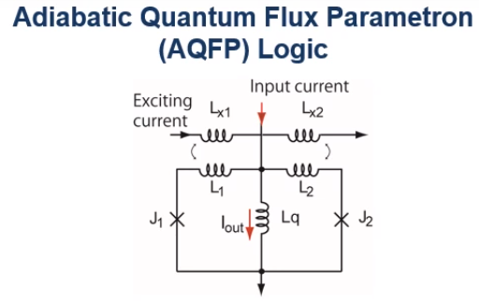
How the Josephson junction works. The Josephson effect produces a current, known as a supercurrent, that flows continuously without any voltage applied, across a device known as a Josephson junction. These consist of two or more superconductors coupled by a weak link. In every AQFP cell, two of these Josephson junctions exist as shown in the diagram.
J1 and J2 are the Josephson junctions within the AQFP cell

Slide 4
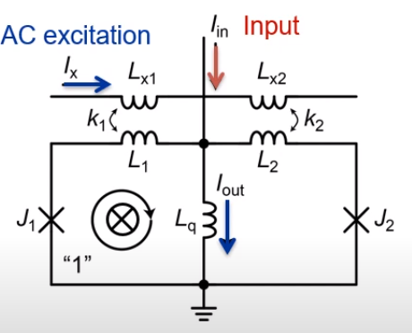
How the AQFP cells work. As shown by the red arrow in the diagram on the left, first an input current is applied. Then an AC excitation current is applied which switches the left Josephson junction and a Single Flux Quanta is entered into the left Josephson junction. The result is a large downward output current as shown in the diagram.

Slide 5
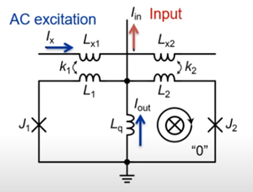
When the input current, shown by the red arrow, is reversed the right Josephson junction switches. This results in a large upward output current. These AQFP cells can be arranged in different ways to create different logic gates such as AND, NAND OR, XOR and other logic gates required to make a full adder and a half adder.

Slide 6
Why do AQFP cells require an AC excitation current? In AQFP cells, an AC excitation current is required rather than a DC excitation current due to the specific way these devices function and the need to avoid certain issues associated with DC excitation. The following are some of these issues.

Slide 7
Flux trapping
AQFP cells rely on the manipulation of quantum flux states, which can become trapped in the presence of a DC bias. Trapped flux can lead to errors and instability in the operation of the device. By using an AC excitation current, the flux oscillates back and forth without getting trapped in one state, ensuring more reliable and error-free operation.

Slide 8
Dynamic State Switching
AQFP logic operations involve the dynamic switching of quantum flux states between different superconducting loops or elements within the cell. AC excitation enables a more controlled and reversible manipulation of the quantum states, allowing for efficient logic operations. In simpler words the AC current acts as a clock for the cell and synchronizes the actions.

Slide 9
Energy Efficiency
Superconducting circuits are known for their energy efficiency, and AQFP is no exception. By using an AC excitation current, the energy dissipation can be kept to a minimum, resulting in lower power consumption during operation

Slide 10
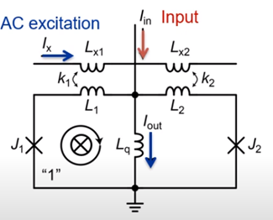

It is my understanding that the direction of the current flowing in the Josephson junction can be used to represent a logical 1 or 0. Example clockwise for 0 counter-clockwise for 1. In the case of the diagram on the right, if the current is induced in the left loop, it is considered 1 and in the right loop, it is considered 0. Adding many of these AQFP cells together and changing the direction of the input current one can modify the function of the cell to act as an AND, NAND or any other logic gate.

Slide 11
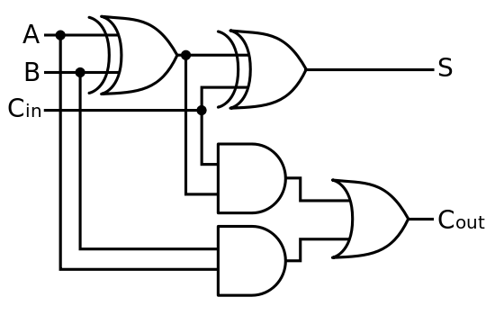
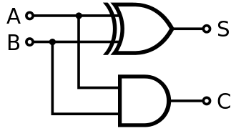
Once I have managed to construct the logic gates, I will use them to build a half adder and a full adder.

